Slide 1

Basics of Neural Network Programming
Gradient Descent
deeplearning.ai

Slide 2
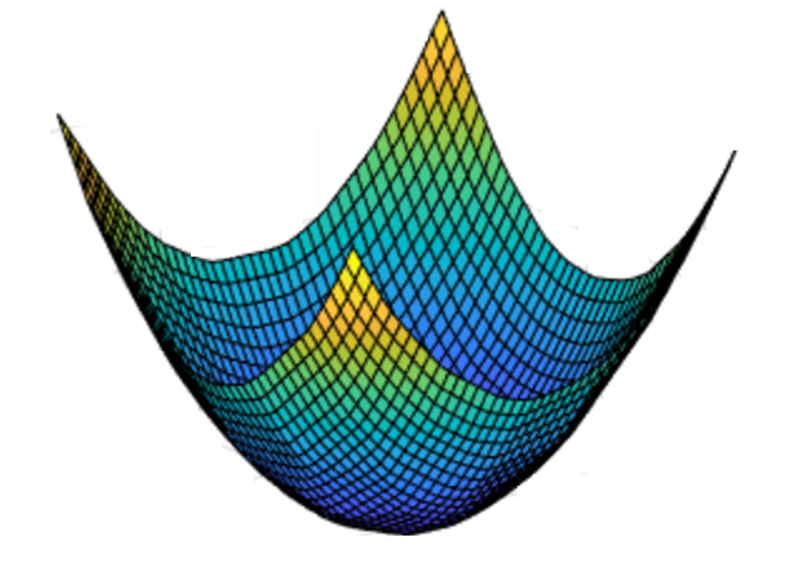
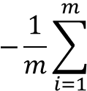
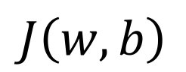

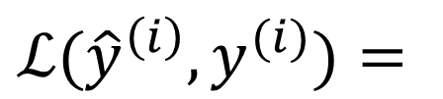
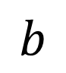
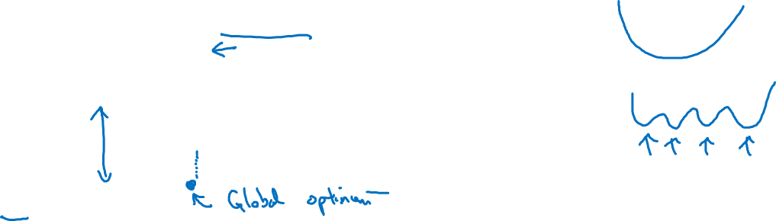
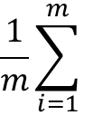
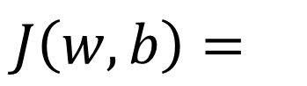


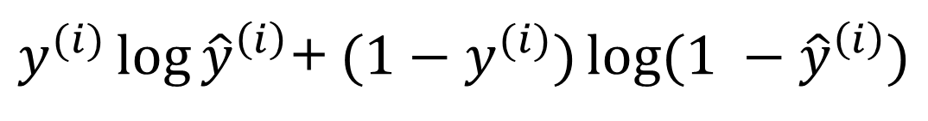

Gradient Descent
Recap: $\hat{y}= σ\left(w^{T}x+b\right)$, $σ\left(z\right)=\frac{1}{1+e^{−z}}$
$$\frac{1}{m}\sum_{i=1}^{m}{ }$$
$ℒ({\hat{y}}^{\left(i\right)},y^{(i)})$ $=$
$$−\frac{1}{m}\sum_{i=1}^{m}{ }$$
$$J\left(w,b\right)=$$
$y^{(i)}\log{{\hat{y}}^{\left(i\right)}}$+ $({1−y}^{(i)})\log{(1 −{\hat{y}}^{\left(i\right)})}$
Want to find $w,b$ that minimize $J\left(w,b\right)$
$$J\left(w,b\right)$$
$$b$$
$$w$$

Slide 3

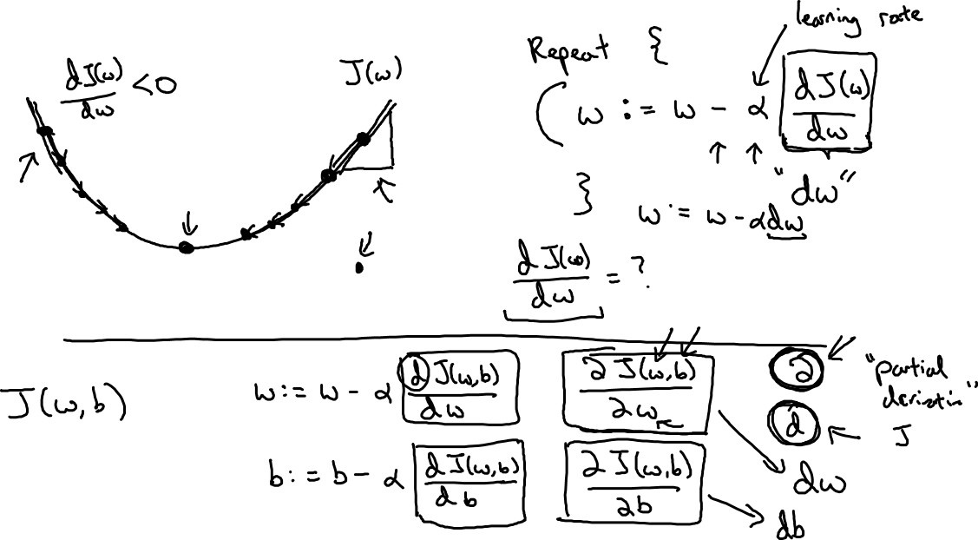
Gradient Descent
$$w$$

Slide 4
Basics of Neural Network Programming
Derivatives
deeplearning.ai

Slide 5
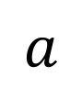
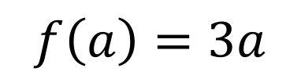
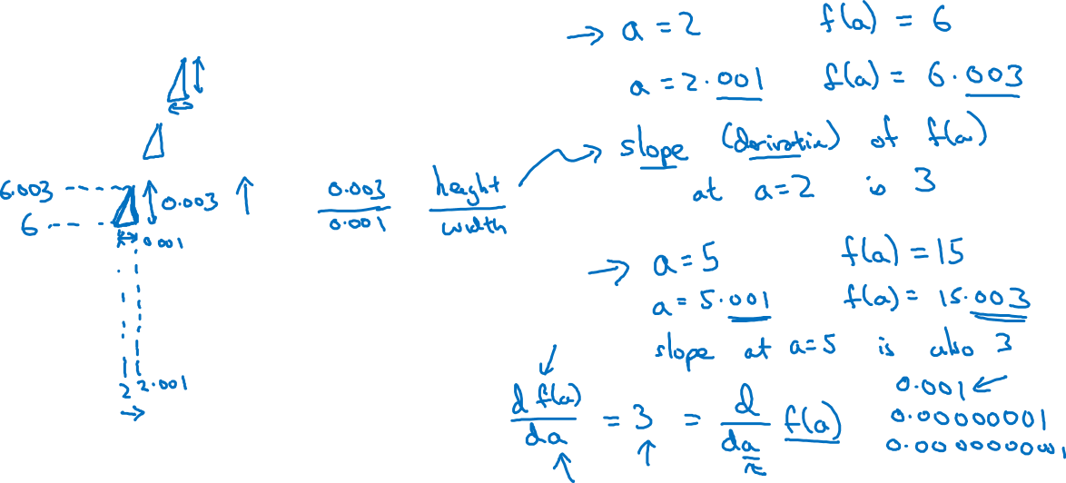
Intuition about derivatives
$$f\left(a\right)=3a$$
$$a$$

Slide 6
Basics of Neural Network Programming
More derivatives examples
deeplearning.ai

Slide 7
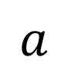
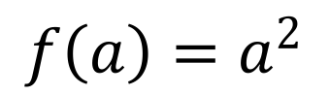
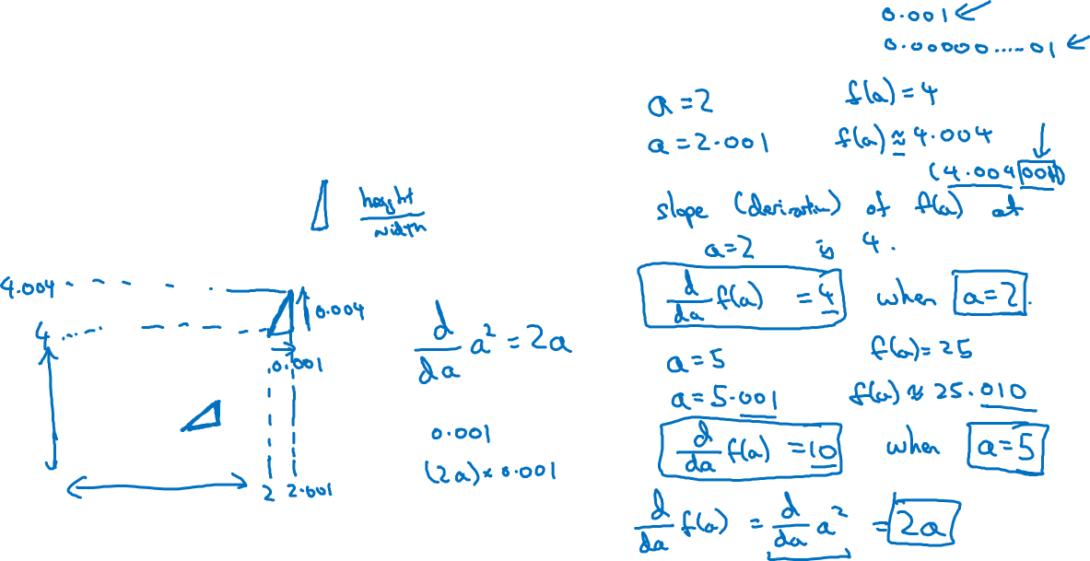
Intuition about derivatives
$$f\left(a\right)=a^{2}$$
$$a$$

Slide 8
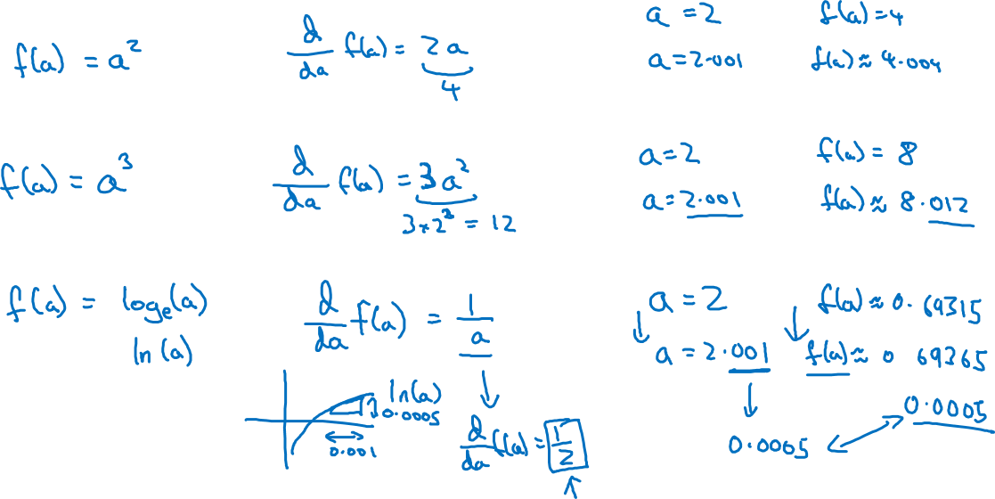
More derivative examples

Slide 9
Basics of Neural Network Programming
Computation Graph
deeplearning.ai

Slide 10
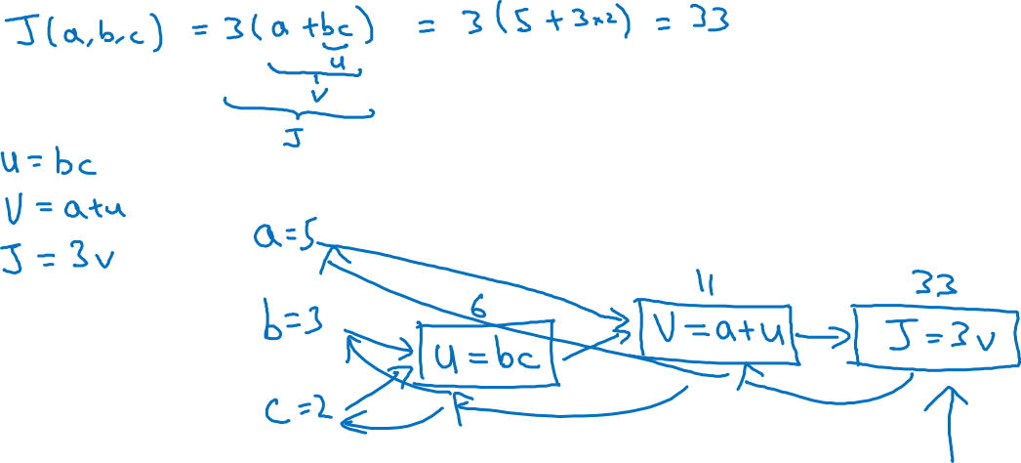
Computation Graph

Slide 11
Basics of Neural Network Programming
Derivatives with a Computation Graph
deeplearning.ai

Slide 12
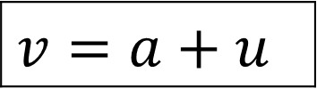
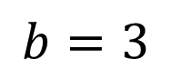
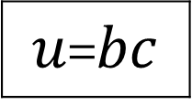
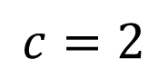
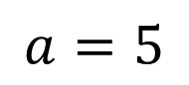
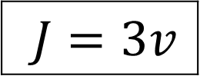
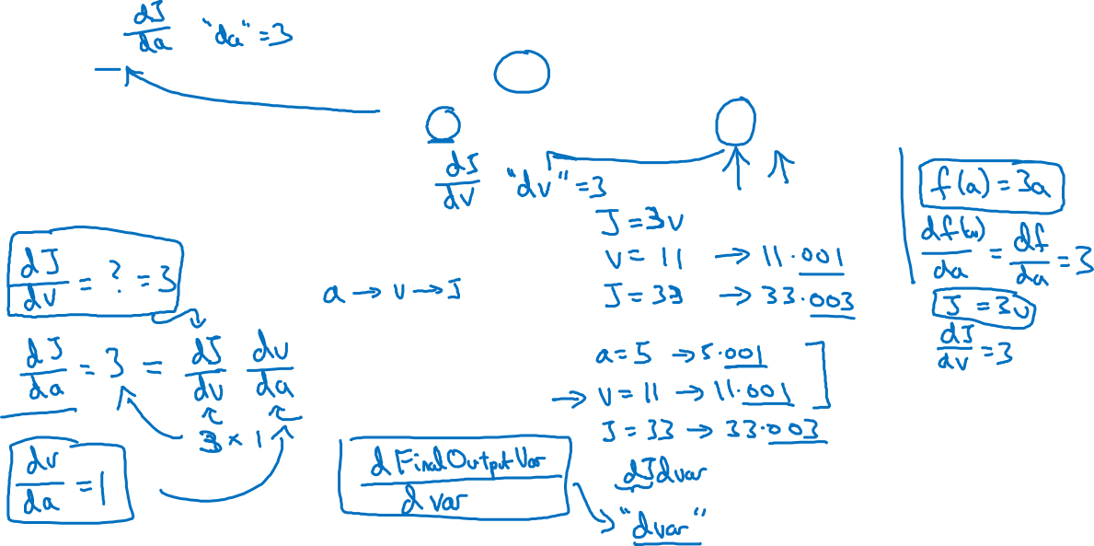
Computing derivatives
$$a=5$$
11
33
$$b=3$$
6
$$v=a+u$$
$J=3v$
$u$=$bc$
$$c=2$$

Slide 13
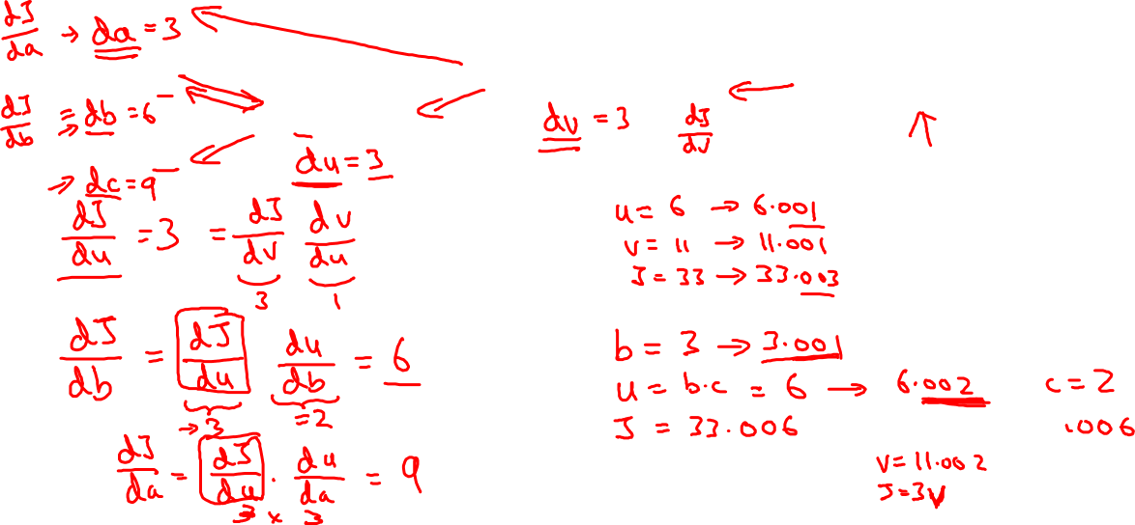
Computing derivatives
$$a=5$$
11
33
$$b=3$$
6
$$v=a+u$$
$J=3v$
$u$=$bc$
$$c=2$$

Slide 14
Basics of Neural Network Programming
Logistic Regression
Gradient descent
deeplearning.ai

Slide 15
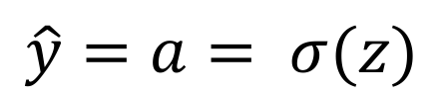
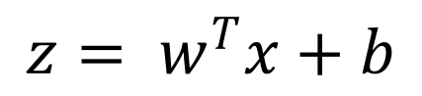
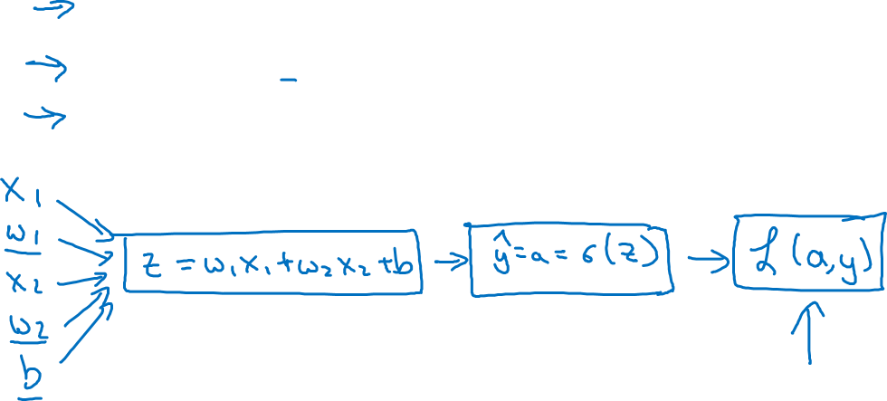
Logistic regression recap
$$z= w^{T}x+b$$
$$\hat{y}=a= σ(z)$$
$$ℒ\left(a,y\right)=−(y\log{(a)+(1−y)\log{(1−a))}}$$

Slide 16
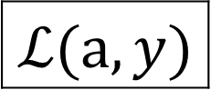
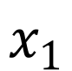
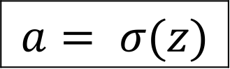
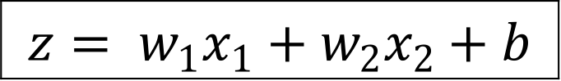
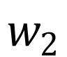
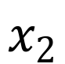
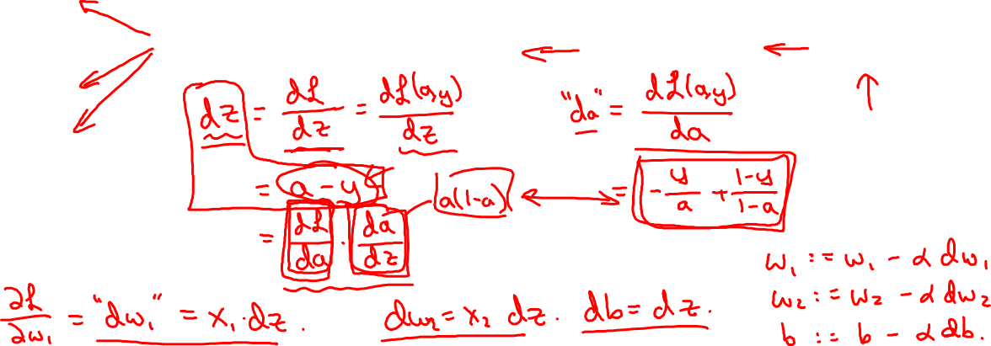
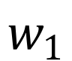
Logistic regression derivatives
$$x_{1}$$
$$w_{1}$$
$$x_{2}$$
$$z= w_{1}x_{1}+w_{2}x_{2}+b$$
$$a= σ(z)$$
$$ℒ(a,y)$$
$$w_{2}$$
b

Slide 17
Basics of Neural Network Programming
Gradient descent
on m examples
deeplearning.ai

Slide 18
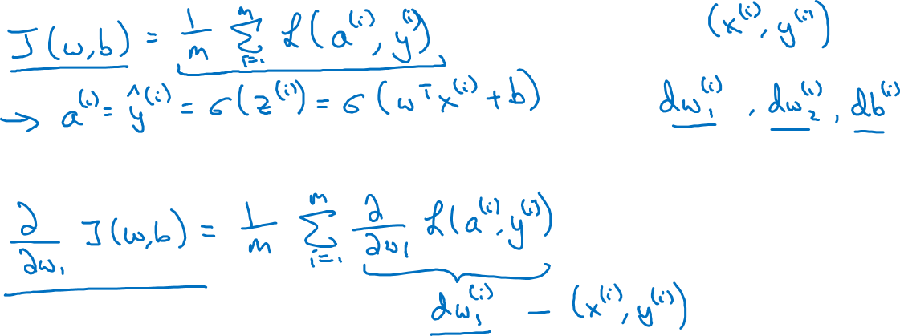
Logistic regression on m examples

Slide 19
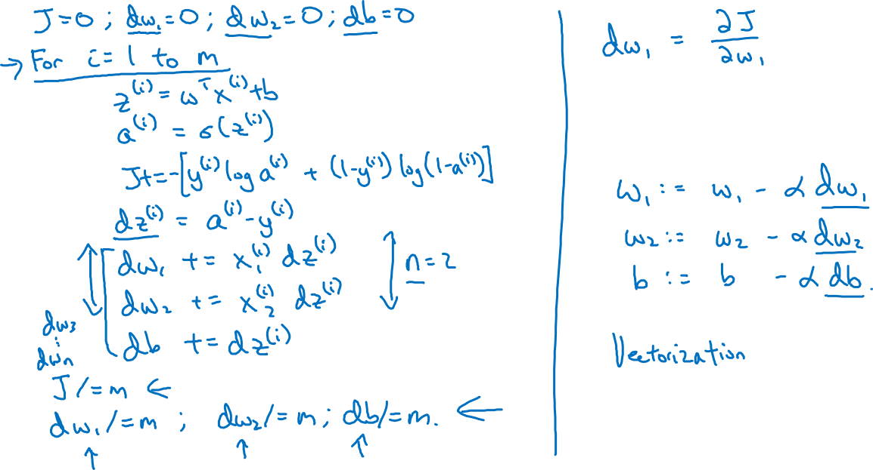
Logistic regression on m examples

Slide 20
Basics of Neural Network Programming
Vectorization
deeplearning.ai

Slide 21
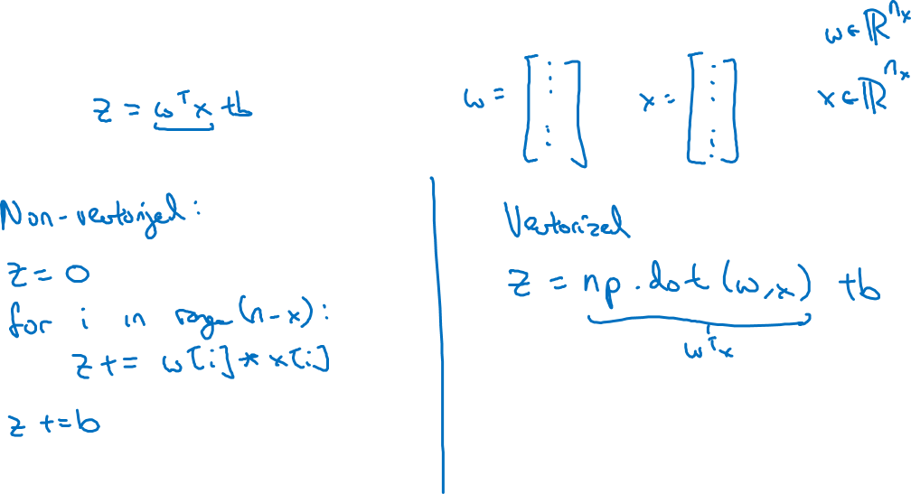
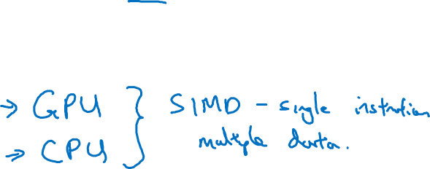
What is vectorization?

Slide 22
Basics of Neural Network Programming
More vectorization
examples
deeplearning.ai

Slide 23
Neural network programming guideline
Whenever possible, avoid explicit for-loops.

Slide 24
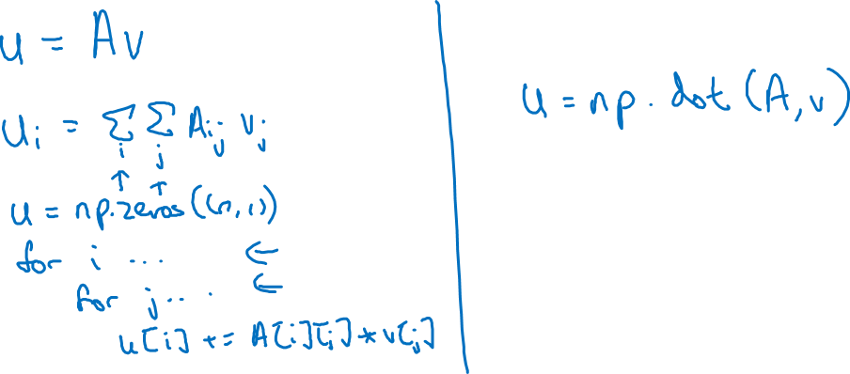
Neural network programming guideline
Whenever possible, avoid explicit for-loops.

Slide 25
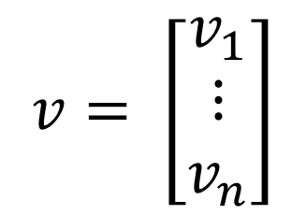
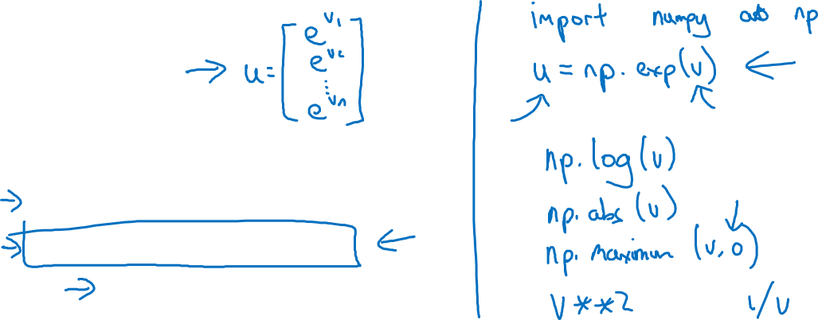
Vectors and matrix valued functions
Say you need to apply the exponential operation on every element of a matrix/vector.
$$v= \left[\begin{matrix}v_{1} \\ ⋮ \\ v_{n}\end{matrix}\right]$$
u = np.zeros((n,1))
for i in range(n):
u[i]=math.exp(v[i])

Slide 26

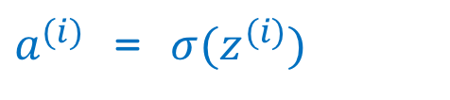
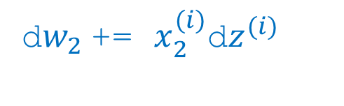
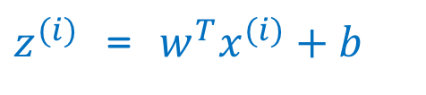

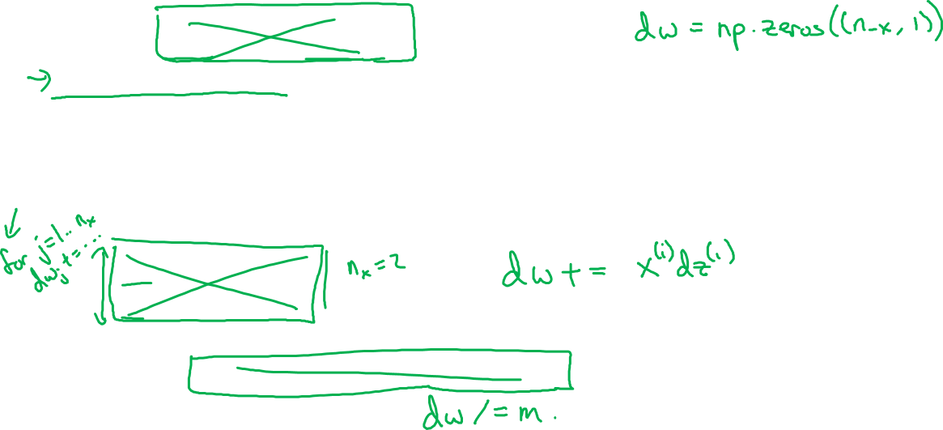
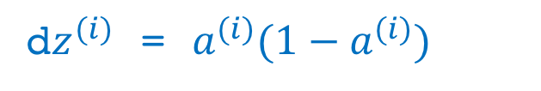
Logistic regression derivatives
J = 0, dw1 = 0, dw2 = 0, db = 0
for i = 1 to n:
$z^{(i)}$ = $w^{T}x^{(i)}+b$
$a^{(i)}$ = $σ{(z}^{(i)})$
$J$+= $−\left[y^{(i)} \log{{\hat{y}}^{\left(i\right)}+({1−y}^{\left(i\right)})\log{(1 −{\hat{y}}^{\left(i\right)})}}\right]$
d$z^{(i)}$ = $a^{(i)}{(1−a}^{(i)})$
d${w_{1}}^{ }$+= $x_{1}^{(i)}\text{d}z^{(i)}$
d${w_{2}}^{ }$+= $x_{2}^{(i)}\text{d}z^{(i)}$
db += d$z^{(i)}$
J = J/m, d$w_{1}$ = d$w_{1}$/m, d$w_{2}$ = d$w_{2}$/m, db = db/m

Slide 27
Basics of Neural Network Programming
Vectorizing Logistic
Regression
deeplearning.ai

Slide 28
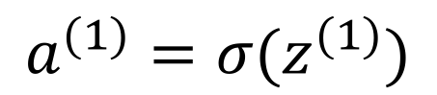






Vectorizing Logistic Regression
$$z^{(1)}=w^{T}x^{(1)}+b$$
$$z^{(2)}=w^{T}x^{(2)}+b$$
$$z^{(3)}=w^{T}x^{(3)}+b$$
$$a^{(1)}={σ(z}^{(1)})$$
$$a^{(2)}={σ(z}^{(2)})$$
$$a^{(3)}={σ(z}^{(3)})$$

Slide 29
Basics of Neural Network Programming
Vectorizing Logistic
Regression’s Gradient
Computation
deeplearning.ai

Slide 30

Vectorizing Logistic Regression

Slide 31





Implementing Logistic Regression
J = 0, d$w_{1}$ = 0, d$w_{2}$ = 0, db = 0
for i = 1 to m:
$z^{(i)}$ = $w^{T}x^{(i)}+b$
$a^{(i)}$ = $σ{(z}^{(i)})$
$J$+= $−\left[y^{(i)} \log{a^{\left(i\right)}+({1−y}^{\left(i\right)})\log{(1 −a^{\left(i\right)})}}\right]$
d$z^{(i)}$ = $a^{(i)}{−y}^{(i)}$
d${w_{1}}^{ }$+= $x_{1}^{(i)}\text{d}z^{(i)}$
d${w_{2}}^{ }$+= $x_{2}^{(i)}\text{d}z^{(i)}$
db += d$z^{(i)}$
J = J/m, d$w_{1}$ = d$w_{1}$/m, d$w_{2}$ = d$w_{2}$/m
db = db/m

Slide 32
Basics of Neural Network Programming
Broadcasting in
Python
deeplearning.ai

Slide 33




Broadcasting example
Calories from Carbs, Proteins, Fats in 100g of different foods:
Apples
Beef
Eggs
Potatoes
Carb
$$\left[\begin{matrix}56.0 & 0.0 & \begin{matrix}4.4 & 68.0\end{matrix} \\ 1.2 & 104.0 & \begin{matrix}52.0 & 8.0\end{matrix} \\ 1.8 & 135.0 & \begin{matrix}99.0 & 0.9\end{matrix}\end{matrix}\right]$$
Protein
Fat
cal = A.sum(axis = 0)
percentage = 100*A/(cal.reshape(1,4))

Slide 34










Broadcasting example
$$\left[\begin{matrix}1 \\ \begin{aligned}\begin{matrix}2 \\ 3\end{matrix} \\ 4\end{aligned}\end{matrix}\right]$$
$$\left[\begin{matrix}101 \\ \begin{aligned}\begin{matrix}102 \\ 103\end{matrix} \\ 104\end{aligned}\end{matrix}\right]$$
$$100$$
=
+
$\left[\begin{matrix}1 & 2 & 3 \\ 4 & 5 & 6\end{matrix}\right]$
$$\left[\begin{matrix}100 & 200 & 300\end{matrix}\right]$$
$$\left[\begin{matrix}101 & 202 & 303 \\ 104 & 205 & 306\end{matrix}\right]$$
+
=
$\left[\begin{matrix}1 & 2 & 3 \\ 4 & 5 & 6\end{matrix}\right]$
$$\left[\begin{matrix}100 \\ 200\end{matrix}\right]$$
$$\left[\begin{matrix}101 & 102 & 103 \\ 204 & 205 & 206\end{matrix}\right]$$
+
=

Slide 35

General Principle

Slide 36
Basics of Neural Network Programming
A note on python/
numpy vectors
deeplearning.ai

Slide 37
Python Demo

Slide 38
Python / numpy vectors
import numpy as np
a = np.random.randn(5)
a = np.random.randn((5,1))
a = np.random.randn((1,5))
assert(a.shape = (5,1))

Slide 39
One hidden layer
Neural Network
Neural Networks
Overview

Slide 40





















What is a Neural Network?
$$x_{1}$$
$$x_{2}$$
$$\hat{y}$$
$$x_{3}$$
x
w
$$z=w^{T}x+b$$
$$a=σ(z)$$
$$ℒ(a,y)$$
b
$$x_{1}$$
$$x_{2}$$
$$\hat{y}$$
$$x_{3}$$
x
$$W^{[1]}$$
$$z^{[1]}=W^{[1]}x+b^{[1]}$$
$$a^{[1]}=σ(z^{[1]})$$
$$z^{[2]}=W^{[2]}a_{ }^{[1]}+b^{[2]}$$
$$a^{[2]}=σ(z^{[2]})$$
$$ℒ(a^{[2]},y)$$
$$b^{[1]}$$
$$W^{[2]}$$
$$b^{[2]}$$

Slide 41
One hidden layer
Neural Network
Neural Network
Representation

Slide 42





Neural Network Representation
$$x_{1}$$
$$x_{2}$$
$$\hat{y}$$
$$x_{3}$$

Slide 43
One hidden layer
Neural Network
Computing a
Neural Network’s
Output

Slide 44











Neural Network Representation
$$x_{1}$$
$$x_{1}$$
$$x_{2}$$
$$σ(z)$$
$$a=\hat{y}$$
$$x_{2}$$
$$\hat{y}$$
$$w^{T}x+b$$
$$z$$
$$a$$
$$x_{3}$$
$$x_{3}$$
$$z=w^{T}x+b$$
$$a=σ(z)$$

Slide 45







Neural Network Representation
$$x_{1}$$
$$x_{1}$$
$$x_{2}$$
$$σ(z)$$
$$a=\hat{y}$$
$$x_{2}$$
$$\hat{y}$$
$$w^{T}x+b$$
$$z$$
$$a$$
$$x_{3}$$
$$x_{3}$$
$$z=w^{T}x+b$$
$$x_{1}$$
$$a=σ(z)$$
$$x_{2}$$
$$\hat{y}$$
$$x_{3}$$

Slide 46













Neural Network Representation
$$a_{1}^{\left[1\right]}$$
$z_{1}^{\left[1\right]}=w_{1}^{{\left[1\right]T}^{ }}x+b_{1}^{[1]}, a_{ 1}^{[1]}=σ(z_{1}^{\left[1\right]}$)
$$x_{1}$$
$$a_{2}^{\left[1\right]}$$
$z_{2}^{\left[1\right]}=w_{2}^{{\left[1\right]T}^{ }}x+b_{2}^{[1]}, a_{ 2}^{[1]}=σ(z_{2}^{\left[1\right]}$)
$$x_{2}$$
$$\hat{y}$$
$$a_{3}^{\left[1\right]}$$
$z_{3}^{\left[1\right]}=w_{3}^{{\left[1\right]T}^{ }}x+b_{3}^{[1]}, a_{ 3}^{[1]}=σ(z_{3}^{\left[1\right]}$)
$$x_{3}$$
$$a_{4}^{\left[1\right]}$$
$z_{4}^{\left[1\right]}=w_{4}^{{\left[1\right]T}^{ }}x+b_{4}^{[1]}, a_{ 4}^{[1]}=σ(z_{4}^{\left[1\right]}$)

Slide 47





Neural Network Representation learning
$$a_{1}^{\left[1\right]}$$
Given input x:
$$x_{1}$$
$$a_{2}^{\left[1\right]}$$
$$z^{\left[1\right]}=W^{\left[1\right]}x+b^{\left[1\right]}$$
$$x_{2}$$
$$\hat{y}$$
$$a_{3}^{\left[1\right]}$$
$$x_{3}$$
$$a^{\left[1\right]}=σ(z^{\left[1\right]})$$
$$a_{4}^{\left[1\right]}$$
$$z^{\left[2\right]}=W^{\left[2\right]}a^{\left[1\right]}+b^{\left[2\right]}$$
$$a^{\left[2\right]}=σ(z^{\left[2\right]})$$

Slide 48
One hidden layer
Neural Network
Vectorizing across
multiple examples

Slide 49






Vectorizing across multiple examples
$$z^{\left[1\right]}=W^{\left[1\right]}x+b^{\left[1\right]}$$
$$x_{1}$$
$$a^{\left[1\right]}=σ(z^{\left[1\right]})$$
$$x_{2}$$
$$\hat{y}$$
$$z^{\left[2\right]}=W^{\left[2\right]}a^{\left[1\right]}+b^{\left[2\right]}$$
$$x_{3}$$
$$a^{\left[2\right]}=σ(z^{\left[2\right]})$$

Slide 50





Vectorizing across multiple examples
for i = 1 to m:
$$z^{\left[1\right](i)}=W^{\left[1\right]}x^{(i)}+b^{\left[1\right]}$$
$$a^{\left[1\right](i)}=σ(z^{\left[1\right]\left(i\right)})$$
$$z^{\left[2\right](i)}=W^{\left[2\right]}a^{\left[1\right](i)}+b^{\left[2\right]}$$
$$a^{\left[2\right](i)}=σ(z^{\left[2\right]\left(i\right)})$$

Slide 51
One hidden layer
Neural Network
Explanation
for vectorized
implementation

Slide 52

Justification for vectorized implementation

Slide 53

















Recap of vectorizing across multiple examples
for i = 1 to m
$$x_{1}$$
$$z^{\left[1\right](i)}=W^{\left[1\right]}x^{(i)}+b^{\left[1\right]}$$
$$x_{2}$$
$$\hat{y}$$
$$x_{3}$$
$$a^{\left[1\right](i)}=σ(z^{\left[1\right]\left(i\right)})$$
$$z^{\left[2\right](i)}=W^{\left[2\right]}a^{\left[1\right](i)}+b^{\left[2\right]}$$
$$a^{\left[2\right](i)}=σ(z^{\left[2\right]\left(i\right)})$$
$$X=$$
$$x^{(1)}$$
$$x^{(2)}$$
…
$$x^{(m)}$$
$$Z^{\left[1\right]}=W^{\left[1\right]}X+b^{\left[1\right]}$$
$$A^{\left[1\right]}=σ(Z^{\left[1\right]})$$
$$Z^{\left[2\right]}=W^{\left[2\right]}A^{\left[1\right]}+b^{\left[2\right]}$$
$A^{[1]}=$
$$a^{[1](1)}$$
$$a^{[1](2)}$$
$$a^{[1](m)}$$
…
$$A^{\left[2\right]}=σ(Z^{\left[2\right]})$$

Slide 54
One hidden layer
Neural Network
Activation functions

Slide 55







Activation functions
$$x_{1}$$
$$x_{2}$$
$$\hat{y}$$
$$x_{3}$$
Given x:
$$z^{\left[1\right]}=W^{\left[1\right]}x+b^{\left[1\right]}$$
$$a^{\left[1\right]}=σ(z^{\left[1\right]})$$
$$z^{\left[2\right]}=W^{\left[2\right]}a^{\left[1\right]}+b^{\left[2\right]}$$
$$a^{\left[2\right]}=σ(z^{\left[2\right]})$$

Slide 56



Pros and cons of activation functions
a
a
x
z
$$a= \frac{1}{1+e^{−z}}$$
sigmoid:
a
a
z
z

Slide 57
One hidden layer
Neural Network
Why do you
need non-linear
activation functions?

Slide 58







Activation function
$$x_{1}$$
$$x_{2}$$
$$\hat{y}$$
$$x_{3}$$
Given x:
$$z^{\left[1\right]}=W^{\left[1\right]}x+b^{\left[1\right]}$$
$$a^{\left[1\right]}=g^{[1]}(z^{\left[1\right]})$$
$$z^{\left[2\right]}=W^{\left[2\right]}a^{\left[1\right]}+b^{\left[2\right]}$$
$$a^{\left[2\right]}=g^{[2]}(z^{\left[2\right]})$$

Slide 59
One hidden layer
Neural Network
Derivatives of
activation functions

Slide 60


Sigmoid activation function
a
$$g(z)= \frac{1}{1+e^{−z}}$$
z

Slide 61


Tanh activation function
a
$$g(z)=tanh(z){ }$$
z

Slide 62

ReLU and Leaky ReLU
a
a
z
z
ReLU
Leaky ReLU

Slide 63
One hidden layer
Neural Network
Gradient descent for
neural networks

Slide 64

Gradient descent for neural networks

Slide 65

Formulas for computing derivatives

Slide 66
One hidden layer
Neural Network
Backpropagation
intuition (Optional)

Slide 67







Computing gradients
Logistic regression
$$x$$
$$w$$
$$z=w^{T}x+b$$
$$a= σ(z)$$
$$ℒ(a,y)$$
$$b$$

Slide 68












Neural network gradients
$$W^{[2]}$$
$$x$$
$$b^{[2]}$$
$$W^{[1]}$$
$$z^{[1]}=W^{[1]}x+b^{[1]}$$
$$a^{[1]}= σ(z^{[1]})$$
$$z^{[2]}=W^{[2]}x+b^{[2]}$$
$$a^{[2]}= σ(z^{[2]})$$
$$ℒ(a^{[2]},y)$$
$$b^{[1]}$$

Slide 69






Summary of gradient descent
$$dz^{[2]}=a^{[2]}−y$$
$$dW^{[2]}=dz^{[2]}a^{{\left[1\right]}^{T}}$$
$$db^{[2]}=dz^{[2]}$$
$$dz^{[1]}=W^{\left[2\right]T}dz^{[2]}∗g^{[1]}′(z^{\left[1\right]})$$
$$dW^{[1]}=dz^{[1]}x^{T}$$
$$db^{[1]}=dz^{[1]}$$

Slide 70





Summary of gradient descent
$$dz^{[2]}=a^{[2]}−y$$
$$dZ^{[2]}=A^{[2]}−Y$$
$$dW^{[2]}=dz^{[2]}a^{{\left[1\right]}^{T}}$$
$$dW^{[2]}=\frac{1}{m}dZ^{[2]}A^{{\left[1\right]}^{T}}$$
$$db^{[2]}=dz^{[2]}$$
$$db^{[2]}=\frac{1}{m}np.sum(dZ^{\left[2\right]},axis=1, keepdims=True)$$
$$dz^{[1]}=W^{\left[2\right]T}dz^{[2]}∗g^{[1]}′(z^{\left[1\right]})$$
$$dZ^{[1]}=W^{\left[2\right]T}dZ^{[2]}∗g^{[1]}′(Z^{\left[1\right]})$$
$$dW^{[1]}=dz^{[1]}x^{T}$$
$$dW^{[1]}=\frac{1}{m}dZ^{[1]}X^{T}$$
$$db^{[1]}=dz^{[1]}$$
$$db^{[1]}=\frac{1}{m}np.sum(dZ^{\left[1\right]},axis=1, keepdims=True)$$

Slide 71
One hidden layer
Neural Network
Random Initialization

Slide 72







What happens if you initialize weights to zero?
$$x_{1}$$
$$a_{1}^{[1]}$$
$$a_{1}^{[2]}$$
$$\hat{y}$$
$$x_{2}$$
$$a_{2}^{[1]}$$

Slide 73

Random initialization
$$x_{1}$$
$$a_{1}^{[1]}$$
$$a_{1}^{[2]}$$
$$\hat{y}$$
$$x_{2}$$
$$a_{2}^{[1]}$$

Slide 74
Deep Neural Networks
Getting your matrix
dimensions right

Slide 75





Parameters $W^{[l]}$ and $b^{[l]}$
$$x_{1}$$
$$\hat{y}$$
$$x_{2}$$

Slide 76


Vectorized implementation
$$x_{1}$$
$$\hat{y}$$
$$x_{2}$$

Slide 77
Deep Neural Networks
Why deep
representations?

Slide 78





Intuition about deep representation
$$\hat{y}$$

Slide 79

Circuit theory and deep learning
Informally: There are functions you can compute with a “small” L-layer deep neural network that shallower networks require exponentially more hidden units to compute.

Slide 80
Deep Neural Networks
Building blocks of
deep neural networks

Slide 81







Forward and backward functions
$$x_{1}$$
$$x_{2}$$
$$\hat{y}$$
$$x_{3}$$
$$x_{4}$$

Slide 82

Forward and backward functions

Slide 83
Deep Neural Networks
Forward and backward
propagation

Slide 84



Forward propagation for layer l
Input $a^{[l−1]}$
O$utput a^{[l]},$cache ($z^{[l]}$)

Slide 85



Backward propagation for layer l
Input ${da}^{[l]}$
O$utput {da}^{\left[l−1\right]},dW^{\left[l\right]},db^{[l]}$

Slide 86

Summary

Slide 87
Deep Neural Networks
Parameters vs
Hyperparameters

Slide 88

What are hyperparameters?
Parameters: $W^{\left[1\right]} ,{ b}^{\left[1\right] }, W^{\left[2\right]} ,b^{\left[2\right] },W^{\left[3\right] }, b^{\left[3\right] }…$

Slide 89


Applied deep learning is a very empirical process
Idea
cost $J$
Experiment
Code
# of iterations

Slide 90
Deep Neural Networks
What does this
have to do with
the brain?

Slide 91













Forward and backward propagation
For example the first activation functions could be ReLU and the last one
Could be sigmoid
$$Z^{[1]}=W^{[1]}X+b^{[1]}$$
$${dZ}^{[L]}=A^{[L]}−Y$$
$$A^{[1]}=g^{\left[1\right]}(Z^{\left[1\right]})$$
$$dW^{[L]}=\frac{1}{m}dZ^{\left[L\right]}A^{{\left[L\right]}^{T}}$$
$$Z^{[2]}=W^{[2]}A^{[1]}+b^{[2]}$$
$$db^{[L]}=\frac{1}{m}np. sum(dZ^{\left[L\right]},axis=1, keepdims=True)$$
$$A^{[2]}=g^{\left[2\right]}(Z^{\left[2\right]})$$
…
$${dZ}^{[L−1]}=dW^{{\left[L\right]}^{T}}dZ^{\left[L\right]}{g^{′}}^{\left[L\right]}(Z^{\left[L−1\right]})$$
$$A^{[L]}=g^{\left[L\right]}\left(Z^{\left[L\right]}\right)=\hat{Y}$$
…
$${dZ}^{[1]}=dW^{{\left[L\right]}^{T}}dZ^{\left[2\right]}{g^{′}}^{\left[1\right]}(Z^{\left[1\right]})$$
$$dW^{[1]}=\frac{1}{m}dZ^{\left[1\right]}A^{{\left[1\right]}^{T}}$$
$$db^{[1]}=\frac{1}{m}np. sum(dZ^{\left[1\right]},axis=1, keepdims=True)$$
Align left/vertical will mess up the equations here

